Slide 1
Unit 1: Basic Concepts
1.1 Thinking Like an Economist

Slide 2
Who would like this candy bar?
Wants _________
Available: 1
THE Economic Problem.

Slide 3
Scarcity
A situation in which the wants of an individual or group exceeds the resources available to satisfy them.
Examples:
Mosquitos in January?
There are only a few but they aren’t scarce.
Rain water levels during a typical August?
There is a lot but its still scarce.

Slide 4
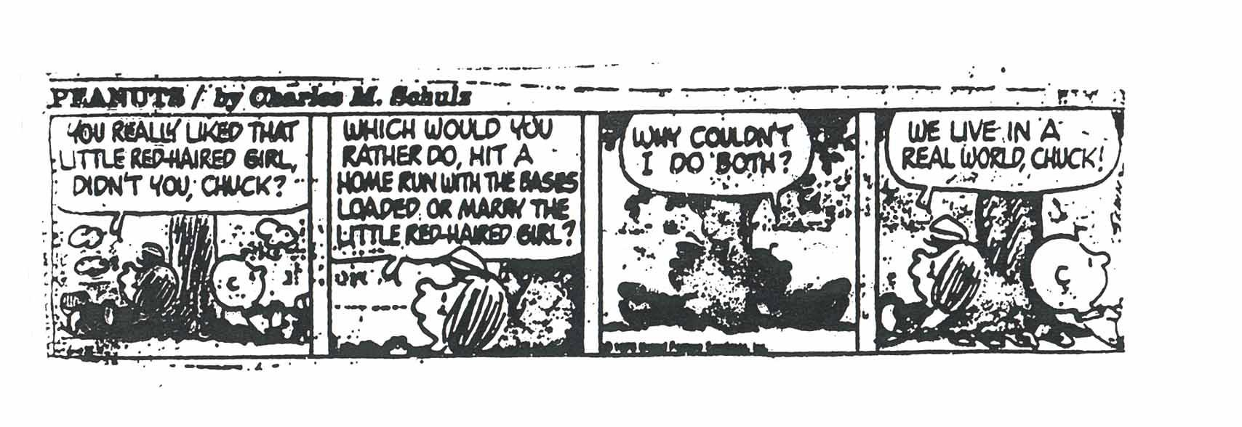
Scarcity = Choice
Because resources are scarce they require us to make a choice. We can’t use the resources for more than one thing at a time. In economics when we evaluate decisions we analysis the trade-offs.

Slide 5
What trade-offs have you made
In coming here today?
In taking an AP class?
In buying a car?
Other examples?

Slide 6
What trade-offs has society made
In expanding Medicare/ Medicaid under the Affordable Health Care Act?
In offering military/humanitarian aide to Syria?
In Florida’s gasoline tax?
In the use of the Atomic Bomb?
Other examples?

Slide 7
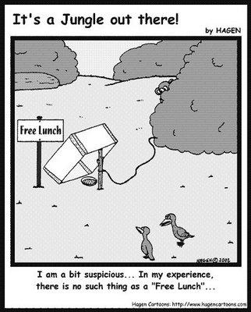
Choice involves Cost
Opportunity Cost: The value of that which must be given up to acquire or achieve something. In other words, the next best option you DID NOT choose.

Slide 8
Lets Practice…..Can you identify the opportunity cost?
https://www.youtube.com/watch?v=io4RWV681wQ

Slide 9
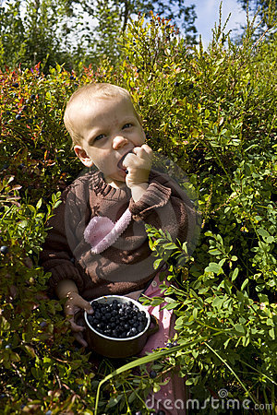
Thinking at the margin: Let’s talk blueberries.
Thinking at the margin means looking at decisions in terms of the effects of small (marginal) changes.

Slide 10
How would you spend $50 million to improve the world’s problems?

Slide 11
All $50B spent

Slide 12
Why are diamonds more expensive than water?
Hint: Its about thinking at the margin.

Slide 13
Microeconomics vs. Macroeconomics
How would you define
the difference?

Slide 14
Incentives Matter
Incentives: a thing that motivates or encourages one to do something.
All choices are based on incentives.

Slide 15
Homework
Watch the Black Rhino Clips below: (If the links don't work, google what is in parenthesis and you should find the videos on YouTube) There are questions in your notes guide that we will be discussing in class tomorrow.
http://www.nbcnews.com/id/21134540/vp/46490720#46490720 (Last Stand - Brian Williams Rock Center)
http://www.nbcnews.com/video/rock-center/47182946#47182946 (Last Stand Revisited - Brian Williams Rock Center)
https://www.youtube.com/watch?v=4r9-WeNXzTQ&feature=youtu.be (Can Hunting Endangered Animals Save the Species)

