Slide 1
Unit 2: Broad Economic Goals
Inflation

Slide 2
What is Inflation?
Inflation is rising general level of prices
Inflation reduces the “purchasing power” of money
Examples:
It takes $2 to buy what $1 bought in 1982
It takes $6 to buy what $1 bought in 1961
When inflation occurs, each dollar of income will buy fewer goods than before.

Slide 3
World Inflation Rates

Slide 4
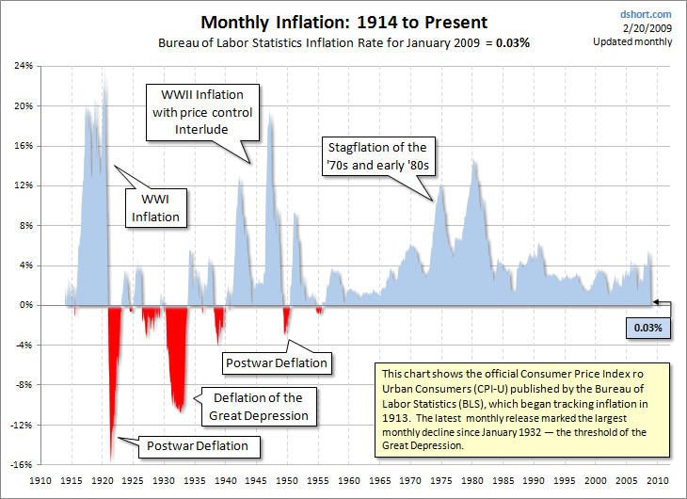

Slide 5
Is Inflation Good or Bad?

Slide 6
Identify which people are helped and which are hurt by unanticipated inflation?
A man who lent out $500 to his friend in 1960 and is still waiting to be paid back.
A tenant who is charged $850 rent each year.
An elderly couple living off fixed retirement payments of $2000 a month
A man that borrowed $1,000 in 1995 and paid it back in 2006
A women who saved a paycheck from 1950 by putting it under her mattress

Slide 7
Identify which people are helped and which are hurt by unanticipated inflation?
A man who lent out $500 to his friend in 1960 and is still waiting to be paid back. hurt
A tenant who is charged $850 rent each year. helped
An elderly couple living off fixed retirement payments of $2000 a month hurt
A man that borrowed $1,000 in 1995 and paid it back in 2006 helped
A women who saved a paycheck from 1950 by putting it under her mattress hurt

Slide 8
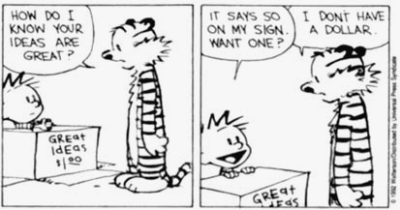
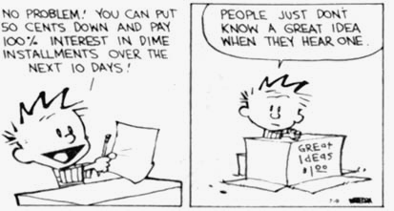
Interest Rates

Slide 9
Interest Rates and Inflation
What are interest rates? Why do lenders charge them?
Who is willing to lend me $100 if I will pay a total interest rate of 100%?
(I plan to pay you back in 2050)
If the nominal interest rate is 10% and the inflation rate is 15%, how much is the REAL interest rate?
Real Interest Rates-
The percentage increase in purchasing power that a borrower pays. (adjusted for inflation)
Real = nominal interest rate - expected inflation
Nominal Interest Rates-
the percentage increase in money that the borrower pays not adjusting for inflation.
Nominal = Real interest rate + expected inflation

Slide 10
Nominal vs. Real Interest Rates
Example #1:
You lend out $100 with 20% interest. Inflation is 15%.
A year later you get paid back $120.
What is the nominal and what is the real interest rate?
Nominal interest rate is 20%. Real interest rate was 5%
In reality, you get paid back an amount with less purchasing power.
Example #2:
You lend out $100 with 10% interest. Prices are expected to increased 20%. In a year you get paid back $110.
What is the nominal and what is the real interest rate?
Nominal interest rate is 10%. Real rate was –10%
In reality, you get paid back an amount with less purchasing power.

Slide 11
Measuring Inflation
Consumer Price Index (CPI)

Slide 12
Consumer Price Index (CPI)
The most commonly used measurement inflation for consumers is the Consumer Price Index
Here is how it works:
The base year is given an index of 100
To compare, each year is given an index # as well
Price of market basket
CPI
=
x 100
Price of market
basket in base year
1997 Market Basket: Movie is $6 & Pizza is $14
Total = $20 (Index of Base Year = 100)
2009 Market Basket: Movie is $8 & Pizza is $17
Total = $25 (Index of )
125
This means inflation increased 25% b/w ’97 & ‘09
Items that cost $100 in ’97 cost $125 in ‘09

Slide 13
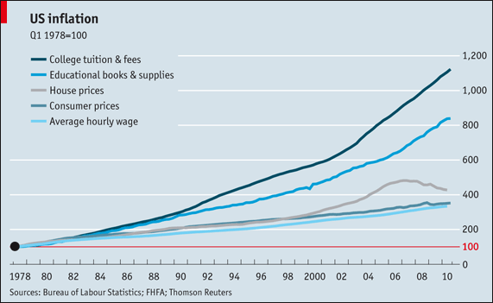

Slide 14
Problems with the CPI
Substitution Bias- As prices increase for the fixed market basket, consumers buy less of these products and more substitutes that may not be part of the market basket. (Result: CPI may be higher than what consumers are really paying)
New Products- The CPI market basket may not include the newest consumer products. (Result: CPI measures prices but not the increase in choices)
Product Quality- The CPI ignores both improvements and decline in product quality. (Result: CPI may suggest that prices stay the same though the economic well being has improved significantly)

Slide 15
Calculating Nominal GDP, Real GDP, and Inflation

Slide 16
Calculating CPI
Nominal,
GDP
CPI/ GDP Deflator (Year 1 as Base Year)
Units of
Output
Price
Per Unit
Real,
GDP
Inflation Rate
Year
1
2
3
4
5
10
10
15
20
25
$ 4
5
6
8
4
Make year one the base year
Price of market basket in the particular year
CPI
=
x 100
Price of the same market
basket in base year

Slide 17
Calculating CPI
Nominal,
GDP
CPI/ GDP Deflator (Year 1 as Base Year)
Units of
Output
Price
Per Unit
Real,
GDP
Inflation Rate
Year
1
2
3
4
5
10
10
15
20
25
$ 4
5
6
8
4
$40
50
90
160
100
$40
40
60
80
100
100
125
150
200
100
N/A
25%
20%
33.33%
-50%
Inflation Rate
=
Year 2 - Year 1
% Change
in Prices
X 100
Year 1

Slide 18
Practice
Real,
GDP
Consumer Price Index
(Year 3 as Base Year)
Units of
Output
Price
Per Unit
Nominal,
GDP
Year
1
2
3
4
5
5
10
20
40
50
$ 6
8
10
12
14
$30
80
200
480
700
$50
100
200
400
500
60
80
100
120
140
Make year three the base year
Price of market basket in the particular year
CPI
=
x 100
Price of the same market
basket in base year

Slide 19
CPI vs. GDP Deflator
The GDP deflator measures the prices of all goods produced, whereas the CPI measures prices of only the goods and services bought by consumers.
An increase in the price of goods bought by firms or the government will show up in the GDP deflator but not in the CPI.
The GDP deflator includes only those goods and services produced domestically. Imported goods are not a part of GDP and therefore don’t show up in the GDP deflator.
Nominal GDP
GDP
Deflator
=
x 100
Real GDP
If the nominal GDP in ’09 was 25 and the real GDP (compared to a base year) was 20 how much is the GDP Deflator?

Slide 20
Calculating GDP Deflator
Nominal GDP
GDP
Deflator
=
x 100
Real GDP
(Deflator) x (Real GDP)
Nominal
GDP
=
100

Slide 21
Calculations
In an economy, Real GDP (base year = 1996) is $100 billion and the Nominal GDP is $150 billion. Calculate the GDP deflator.
In an economy, Real GDP (base year = 1996) is $125 billion and the Nominal GDP is $150 billion. Calculate the GDP deflator.
In an economy, Real GDP for year 2002 (base year = 1996) is $200 billion and the GDP deflator 2002 (base year = 1996) is 120. Calculate the Nominal GDP for 2002.
In an economy, Nominal GDP for year 2005 (base year = 1996) is $60 billion and the GDP deflator 2005 (base year = 1996) is 120. Calculate the Real GDP for 2005.
Notes:
GDP deflator=150
GDP deflator=120
Nominal GDP=$240 billion
Real GDP=$50

Slide 22
Three Causes of Inflation
If everyone suddenly had a million dollars, what would happen?
What two things cause prices to increase? Use Supply and Demand

Slide 23
3 Causes of Inflation
1. The Government Prints TOO MUCH Money (The Quantity Theory)
Governments that keep printing money to pay debts end up with hyperinflation.
There are more “rich” people but the same amount of products.
Result: Banks refuse to lend and GDP falls
Examples:
Bolivia, Peru, Brazil
Germany after WWI

Slide 24
Quantity Theory of Money
If the real GDP in a year is $400 billion but the amount of money in the economy is only $100 billion, how are we paying for things?
The velocity of money is the average times a dollar is spent and re-spent in a year.
How much is the velocity of money in the above example?
Quanity Theory of Money Equation:
M x V = P x Y
M = money supply P = price level
V = velocity Y = quantity of output
Notice that P x Y is GDP
24

Slide 25
M x V = P x Y
Why does printing money lead to inflation?
Assume the velocity is relatively constant because people's spending habits are not quick to change.
Also assume that output (Y) is not affected by the amount of money because it is based on production, not the value of the stuff produced.
If the govenment increases the amount of money (M) what will happen to prices (P)?
Ex: Assume money supply is $5 and it is being used to buy 10 products with a price of $2 each.
1. How much is the velocity of money?
2. If the velocity and output stay the same, what will happen if the amount of money is increase to $10?
Notice, doubling the money supply doubles prices
25

Slide 26
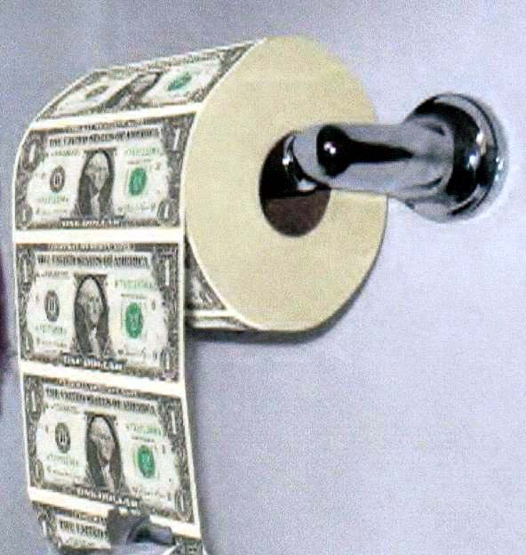
What would happen if the government printed money to pay off the national debt all at once?

Slide 27
3 Causes of Inflation
2. DEMAND-PULL INFLATION
“Too many dollars chasing too few goods”
DEMAND PULLS UP PRICES!!!
Demand increases but supply stays the same. What is the result?
A Shortage driving prices up
An overheated economy with excessive spending but same amount of goods.

Slide 28
3 Causes of Inflation
3. COST-PUSH INFLATION
Higher production costs increase prices
A negative supply shock increases the costs of production and forces producers to increase prices.
Examples:
Hurricane Katrina destroyed oil refineries and causes gas prices to go up. Companies that use gas increase their prices.

Slide 29
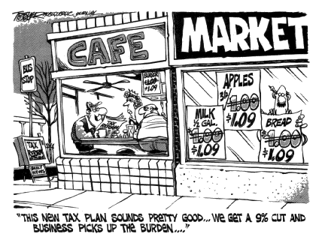
Cost-Push Inflation

