Slide 1
Unit 5: Extended Aggregate Models, Growth & Stability
National Debt

Slide 2
Refresher:Budget Process
The legislative and executive branches work together to create the spending plan for the next fiscal year. Because there are so many people involved, this process can be very time consuming and must be started as early as 18 months before the October 1st budget start date.
Federal agencies send requests for money to the Office of Management and Budget (OMB).
The President vetoes the budget. Congress can try to override the veto with a 2/3rd majority. If they cannot override the veto they must work with the President to create a new compromise budget.
The OMB works with the President to create a budget. This budget is then sent to Congress.
Congress makes changes to the budget and sends it back to the President to be signed into law.
The President signs the budget into law.
Notes:
Maybe put some color into the organizer to change up the red. Also, maybe make the side note a text box with a “fill color”.

Slide 3
What is the national debt?
Money the federal government owes. It is the deficits since 1776 minus surpluses.

Slide 4
What is a budget deficit and Surplus?
Surplus- spend less than they have. Deficit- spend more than they have.

Slide 5
Budget Surplus
Defined: A budget surplus is how much money the Federal Government has in excess to what it plans to spend.
Total Revenue
How much money the government has to spend.
d
National Budget
How much the government plans to spend
Deficit
Surplus
A budget surplus occurs when the government spends less money then it brings in.
Notes:
Same point from slide 5

Slide 6
Budget Deficits
Defined: A budget deficit is how much money the Federal Government plans to spend that they do not have revenue to cover.
National Budget
How much the government plans to spend.
Funded Spending
Spending there is money to pay for.
Deficit
A budget deficit occurs when the government spends more money than it brings in.
Notes:
I think I’ll create some kind of
“Some kind of”…
The graphic organizer is a bit vague for me. Perhaps put a side text box explaining it.
I

Slide 7
Responding To a Deficit
When there is a budget deficit Congress must either cut spending or find alternative ways to fund the deficit. There are two ways they can come up with additional revenue but each has its own challenges.
1. Create Money: The government can print more money to pay for the additional spending but this can lead to inflation.
2. Borrowing Money: The government can borrow money by issuing bonds. Borrowing to fund the deficits adds to the national debt. This is the the option generally taken.
Notes:
Maybe use numbers instead of bullets to ground that these are the two ways for additional revenue

Slide 8
Why don’t they cut spending?
Spending cuts are unpopular because it means the government would have to terminate or cut back on programs.
There is also little incentive for politicians to fight for spending cuts because most of the benefits of spending cuts would be seen in other districts that they are not responsible for.

Slide 9
The Current National Debt
Click here to see the national debt in real time.

Slide 10
How Did the National debt get so large?!!
Yep. The national debt is huge! Just to give you some perspective click on the link below to see what a trillion dollars looks like.
Media outlets and politicians spend a lot of time pointing fingers and assigning blame. Lets take a look at some historical data to see if we can clarify trends in the U.S. debt pattern.
Notes:
http://www.pagetutor.com/trillion/index.html

Slide 11
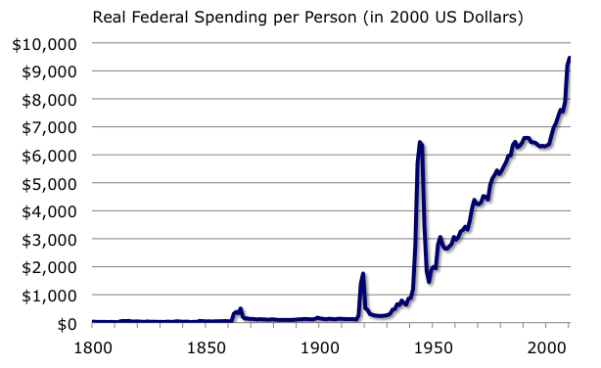
Notice that there tends to be more spending during war periods with a sharp reduction
once the war has concluded. Also notice the consistently upward trend of spending since
The First World War (1918) which has only increased in the past twenty-thirty years.
Notes:
This graph is on my school computer. I will add it and a few others including one on the political business cycle that I am pretty sure I have.

Slide 12
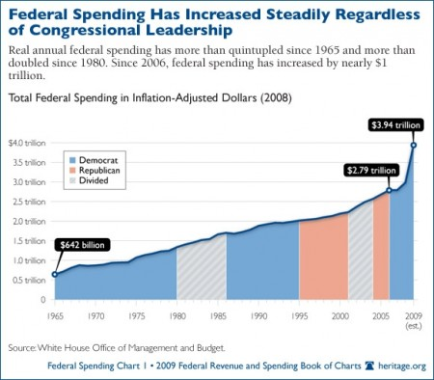
Notice that Congress has followed a steady upward trend in spending since 1965 regardless of
which political party held majority control of Congress.

Slide 13
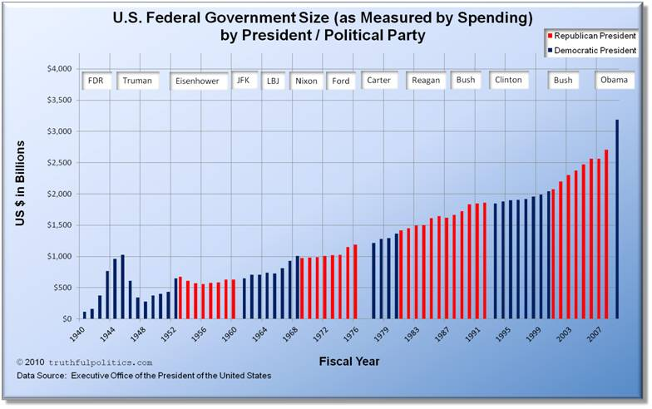
Notice that the upward trend doesn’t seem to be dependent on Presidential party affiliation
either. The upward trend holds regardless of party.

Slide 14
Earlier in this lesson we saw that mandatory spending was becoming a larger and larger
portion of the overall budget. As mandatory spending increases it forces Congress to run
deficits in order to maintain current programs and initiatives without increasing taxes.
What Drives Our Debt?
(Government Spending as a Share of Economy)
25
20
15
10
5
0
Government Spending
as a Share of GDP (%)
Medicare
Medicaid & Other Health
Social Security
1970 1980 1990 2000 2010 2020 2030

Slide 15
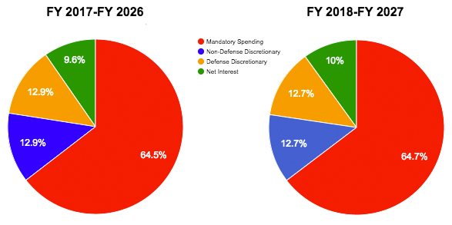
Refresher: Government Spending is divided into two categories, mandatory and discretionary.
Mandatory: Spending that is required by existing law.
Social Security
Discretionary: Spending where there is choice.
Defense
Medicare
Interest Payments on Debt
Education
National Parks & Monuments
Notes:
I think this needs a graphic or estimate about the proportion of mandatory to discretionary…..thoughts?
I think that it is good, concise and directly on target for content. The pie is a nice touch of Jeopardy knowledge. The top writing is a little tough to see though.

Slide 16
Conclusions
What can we conclude from these graphs?
Government spending has been on an upward trend since the Great Depression.
Political party affiliation seems to have little impact on this trend. In other words, everyone has been spending.
Mandatory spending, largely on entitlement programs, is making up a larger and larger share of the annual budget.

Slide 17
What will happen if the debt if isn’t brought under control?
The political attractiveness of borrowing money is obvious. It allows elected political officials to favor projects with immediate highly visible results while delaying the cost economist call this the short-sidedness effect.
But what will happen if the debt just continues to grow larger?
As a nation’s debt gets larger in relation to the size of their economy
(GDP/debt ratio) it becomes riskier to extend them loans. Imagine that the national debt is like a credit card. The more money you borrow the higher your minimum payment gets. The U.S. may soon reach the point where we can no longer afford the minimum payments on our debt.
The more money the United States borrows the higher interest it will have to pay on those loans. The more money we borrow the higher the chance we won’t be able to repay those debts. To compensate for this additional risk the lenders will charge additional interest.
Notes:
The font is a little small on the bottom, maybe enlarge it slightly if it is possible

