Slide 1
Unit 5: Extended Aggregate Models, Growth & Stability
Comparing Macro Theories

Slide 2
Controversy
Before the Great Depression in the early 20th century there was very little discussion of government intervention to stabilize markets.
When the Great Depression started it was a severe contraction in the business cycle. Poor monetary and fiscal policy decisions pushed the U.S. further into the contraction leading to a full blown depression.
As the severity continued to increase people were unwilling to wait for the natural business cycle to correct itself. This is the beginning of the debates on the role that governments should play in stabilizing an economy.
Not everyone agrees on the best role for government in an economy. Just like the difference you see between the major political parties. Economist disagree over which economic theory is the most effective strategy for government’s to follow.
In this lesson we will explore four of the leading economic theories in today’s debates.

Slide 3
Classical Theory
As you have already learned free markets are based on the idea that all people act in their self-interest. To that end markets are self-regulating as everyone naturally moves to their most efficient potential. The classical theory holds that because markets are self regulating no government intervention is necessary.
Classical theory holds that government intervention only creates complications in the market. Recessions are the economy’s way of naturally purging itself of inefficient producers. When the government intervenes they choose which producers will or won’t survive the economic downturn thwarting the invisible hand.
Classical theory was the prevailing economic practice of governments until the Great Depression.

Slide 4
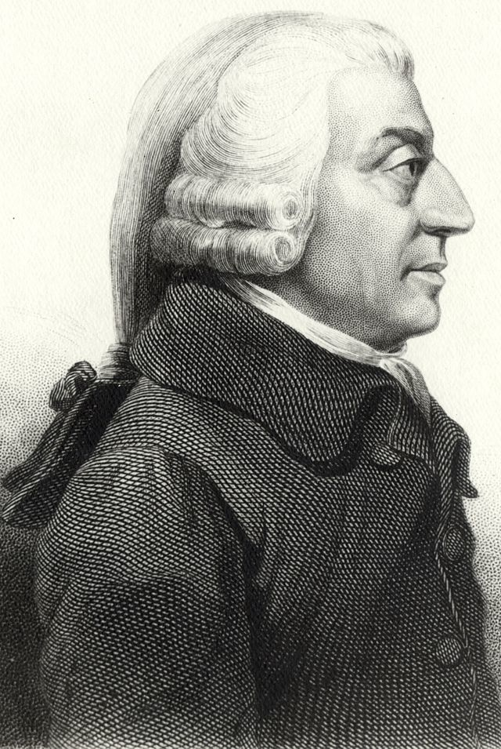
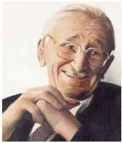
Strengths
The market will always find equilibrium.
Weaknesses
The business cycle may take a long time to balance.
Major Supporters:
Adam Smith
F.A. Hayek
Notes:
Insert video.

Slide 5
School of Thought | Recessions are caused by: | In a recession fiscal policy should be: | In a recession monetary policy should be: | In the long run:
Classical | Government intervention in the market. | Not used. | Not used. However a stable money supply should be maintained. | The business cycle will naturally balance itself.
Keynesian
Supply-Side
Monetarist

Slide 6
Keynesian Theory
The severity of the Great Depression lead to the acceptance of the Keynesian Theory. John Maynard Keynes was a British economist who theorized that fiscal policy should be used to correct and stabilize the economy.
When the economy is in a down turn the government should increase spending to stimulate aggregate demand, pulling the economy out of the down turn.
When the economy is in a growth period the government should decrease spending to slow economic growth to a manageable level.

Slide 7
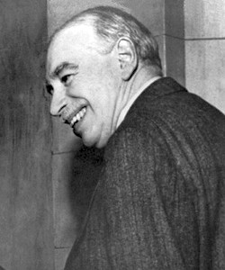
Strengths
Government spending can have a greater multiplier effect on GDP then other changes.
Weaknesses
Often leads to the growth of inefficient, corrupted spending.
Difficult to fine tune fiscal policy. Small changes are difficult to make because of the way government spending is determined.
Easy to increase national debt as large deficits are run.
Government because they can borrow or print money are not limited in their spending.
Major Supporter: John Maynard Keynes

Slide 8
School of Thought | Recessions are caused by: | In a recession fiscal policy should be: | In a recession monetary policy should be: | In the long run:
Classical | Government intervention in the market. | Not used. | Not used. However a stable money supply should be maintained. | The business cycle will naturally balance itself.
Keynesian | Insufficient aggregate demand | Increased government spending even if it means running large deficits. | Keynesian theory doesn’t believe that monetary policy is a very effective means of stabilization. | “We are all dead.” –John M. Keynes There is no need to worry about the long run because it is so far away.
Supply-Side
Monetarist

Slide 9
Supply-side Theory
Supply-side theory agrees with Keynesian theory on the importance of fiscal policy however supply-siders focus on taxation as a means of stimulating an economy.
The heart of the argument is the idea that lowering taxes will increase output (supply) to the point that the government will actually collect more taxes at the new, lower rate.

Slide 10
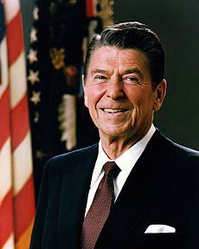
Strengths
Lowering taxes will increase overall tax revenue as more business are open and more investments made.
Weaknesses
Arguments that supply-side policies increases the gap between rich and poor.
Deregulation of some industries may lead to unknown costs later.
Deregulation and lower taxes make it easier for businesses and entrepreneurs to create new businesses.
Major Supporter: Ronald Regan

Slide 11
School of Thought | Recessions are caused by: | In a recession fiscal policy should be: | In a recession monetary policy should be: | In the long run:
Classical | Government intervention in the market. | Not used. | Not used. However a stable money supply should be maintained. | The business cycle will naturally balance itself.
Keynesian | Insufficient aggregate demand | Increased government spending. | Easy money policy though it isn’t believed to be very effective. | “We are all dead.” –John M. Keynes T
Supply-Side | Insufficient aggregate demand | Decreased taxation. | Not a very effective means of stabilization but should focus on keeping the money supply stable. | The increased revenue will balance out the deficits created due to decreased taxation.
Monetarist

Slide 12
Keynes vs. Hayek
Keynes represents government playing the role of a economic stabilizer. Hayek represents the classical market view where the government causes problems with its attempts to stabilize.
Watch the videos on the next two pages.
Notes:
Round 1 or Round 2?

Slide 13
Monetarist Theory
Monetarist theory holds that monetary policy not fiscal policy is the better economic stabilizer. Monetarist theorize that if the money supply (ie. Interest rates) is grown at a steady consistent rate that demand/GDP will grow at the same consistent rate.
Monetarist focus on controlling inflation.

Slide 14
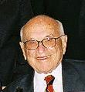
Strengths
The money supply, because it is controlled by the Fed, is less likely to be politically swayed in their policy.
The money supply is easier to control and manipulate than fiscal policy.
Weaknesses
Controlling the money supply too strictly can lead to recessions.
You can not force people to borrow money or banks to lend which can reduce effectiveness.
Major Supporter: Milton Friedman

Slide 15
School of Thought | Recessions are caused by: | In a recession fiscal policy should be: | In a recession monetary policy should be: | In the long run:
Classical | Government intervention in the market. | Not used. | Not used. However a stable money supply should be maintained. | The business cycle will naturally balance itself.
Keynesian | Insufficient aggregate demand | Increased government spending. | Easy money policy. | “We are all dead.” –John M. Keynes T
Supply-Side | Insufficient aggregate demand | Decreased taxation. | Not a very effective means of stabilization. | The increased revenue will balance out the deficits created due to decreased taxation.
Monetarist | An incorrectly set level of the money supply | Not a very effective means of stabilization. | Fed should maintain their long-run money growth rule. | The business cycle will reach/maintain full employment.

