Slide 1
&
What do they teach? How are they similar and different?

Slide 2
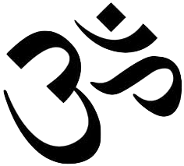
R E L
I G I O
N
&
T
E N E T S:
There are four goals in life:
- Karma: You will be rewarded (or punished) in the next life based on decisions made in this one.
- Dharma: Living up to the duties and obligations in your life.
- Artha: A positive attitude to adapt to environment to be successful and prosperous.
- Moksha: Reach an enlightened state of happiness due to proper living and self-restraint.

Slide 3
R E
I N C A R N A T
I O N:
Like Buddhism, Hinduism teaches that reincarnation takes place until a soul reaches moksha.
Souls are reborn based on karma: if one lives a good life, he or she will be rewarded for it. If not, one will be moved down a level.

Slide 4
The goal in Hinduism is to reach “Moksha.” This is when a soul is freed from the reincarnation cycle.
To get here, followers live a life of good deeds, free from material possessions and personal desires, with constant study, devotion, and meditation toward God.
W T S
A O A
Y L
V
A
T
I
O
N :

Slide 5
F
O
U
N
D
E
R:
There is no single founder of Hinduism. It began as a culture, a way of life, and thus never grew around a single person.

Slide 6
O
R
I
G
I
N:
Originated in India and has mostly stayed contained within India.

Slide 7
F
O
L
L
O
W
E
R
S:
Followers are known as Hindus and there are approximately 1 billion throughout world.
This is roughly 15% of the world’s population.

Slide 8
Vedas:
  This collection of four writings guide Hindus in their daily lives.
S
C
R
I
P
T
U
R
E:
Upanishads:
  This writing focuses on reincarnation and the transformation of one’s soul.

Slide 9
Some say Hinduism has many Gods while others say it only has one.
The main God is called Brahman (the Creator).
Others include:
Vishnu (the Preserver)
Shiva (the Destroyer)
Ganesha (Remover of Obstacles)
G
O
D
S:

Slide 10
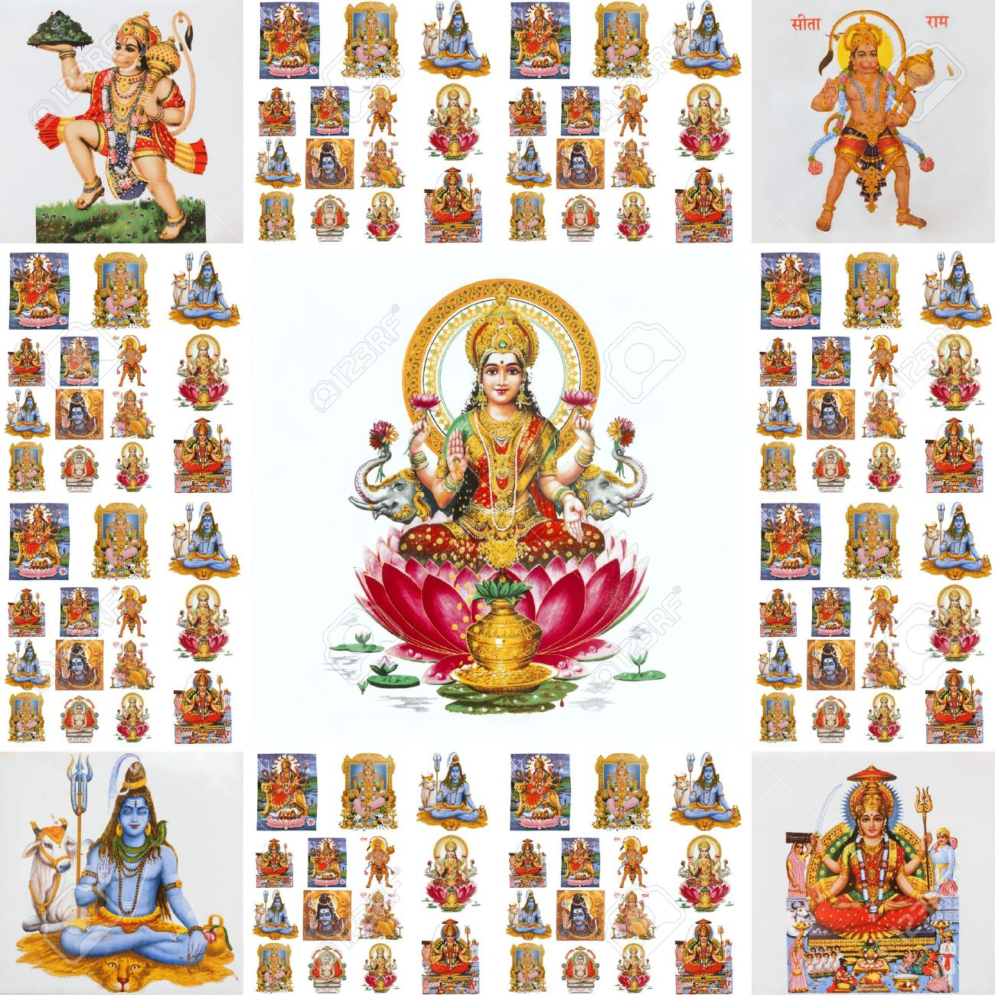
But these are just a few of the Hindu Gods!

Slide 11

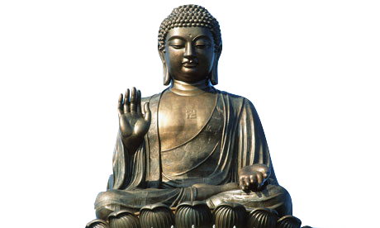
R E L
I G I O
N
&
T
E N E T S:
- More of a way of life than a religion.
One’s life goal must be to reach Nirvana.
  (a state of perfect happiness and bliss)
To reach Nirvana, one must follow the Four Noble Truths.
  1.) Life is suffering
  2.) Suffering is caused from desire
  3.) Ending desire will end suffering
  4.) Follow the 8-Fold Path

Slide 12
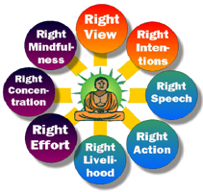
R E L I G I O
N
&
T
E N E T S:

Slide 13
R E
I N C A R N A T
I O N:
A soul that has not reached Nirvana will continue to be reborn into society.
Where one’s soul will be reborn is based on the actions in that soul’s past life. For example, if one makes bad choices that soul may go from a human to an animal. This is called one’s karma.

Slide 14
Buddhism was founded by
Siddhartha Gautama, a prince
whose father ruled over the Sakya
people in modern-day Nepal.
He was ordered to live a life of seclusion, until he ventured out to see how much suffering was in the world.
He committed his life to helping people end their suffering by giving up material attachments.
F
O
U
N
D
E
R:

Slide 15
O
R
I
G
I
N:
Originated in India, later to spread to China along trade routes.

Slide 16
The goal in Buddhism is to reach “Nirvana,” the perfect state of happiness and balance in life.
To get here, followers must let go of all desires, cravings, and material attachments since these cause suffering.
W T S
A O A
Y L
V
A
T
I
O
N :

Slide 17
G
O
D
S:
Since Buddhism is viewed as a way of life and not a religion, Buddhists do not believe in a God.
Siddhartha Gautama is the founder; however he is not a God.

Slide 18
F
O
L
L
O
W
E
R
S:
Followers are known as Buddhists and there are approximately 350 million throughout world.
This is roughly 6% of the world’s population.

Slide 19
S
C
R
I
P
T
U
R
E:
Tripitaka:
  3 books compiled by monks after the death of Gautama that explain the teachings of the Buddha.

Slide 20
K
A
R
M
A
&
D
H
A
R
M
A:
The concepts of Karma and Dharma are fairly similar in both faiths:
Both see Karma as the belief that past actions have an impact on present and future events.
To Buddhists, Dharma represents all the teachings of the Buddha and to live like he did. To Hindus, Dharma is the idea of living a proper life, including prayer and fulfilling their responsibilities toward their friends, family, and society.

